Slide 1
Promotion Report
副研究员I
Huang Boyuan
SEB,SRCB
2018-03-13
助理研究员III
© 2018Ricoh Software Research Center (Beijing) Co., Ltd.
Notes:
Good afternoon everyone, thank you so much for attending my promotion report and it’s very appreciate for giving me second chance. In the conference, the target of this promotion is from Assistant Researcher III to Deputy Researcher I.

Slide 2
Content
Personal Information
Project involved
Future and Plan
© 2018 Ricoh Software Research Center (Beijing) Co., Ltd.
2
Notes:
My report contain 3 parts: they are personal information, project involved ,and the last one is future and plan

Slide 3
Personal Information
Education Experience
2005 ~ 2009 | Beihang University | Bachelor’s degree | Mechanical Engineering
2010 ~ 2013 | Beihang University | Master’s degree | Aviation and aerospace manufacturing
Working Experience
2014 ~ 2015 | CAXA | Software Engineer
2015 ~ now | SRCB | Assistant Researcher III
© 2018 Ricoh Software Research Center (Beijing) Co., Ltd.
3
Notes:
I studied in Beihang University from 2005 to 2013.
In this university, I get my bachelor’s and Master’s degree, which is a bachelor of Mechanical Engineering, and Master’s degree of Aviation and aerospace manufacturing.
Then I joined CAXA, the largest industry software company in China, as a software engineer.
After that , I joined SRCB as an assistant researcher in 2015.
Thanks to the rich experience in kinds of industry, I have a quite wide rage of knowledge in the grate industry and this can help me to think an idea from different discipline, and it’s a quite important abilities to resolve kinds of complex problems.

Slide 4
Personal Information
Specialty
Wide rage of knowledge to resolve complex problems
Engineering
Programme
Language
Presentation
Core Competitiveness
© 2018 Ricoh Software Research Center (Beijing) Co., Ltd.
4
Notes:
I studied in Beihang University from 2005 to 2013.
In this university, I get my bachelor’s and Master’s degree, which is a bachelor of Mechanical Engineering, and Master’s degree of Aviation and aerospace manufacturing.
Then I joined CAXA, the largest industry software company in China, as a software engineer.
After that , I joined SRCB as an assistant researcher in 2015.
Thanks to the rich experience in kinds of industry, I have a quite wide rage of knowledge in the grate industry and this can help me to think an idea from different discipline, and it’s a quite important abilities to resolve kinds of complex problems.

Slide 5
Content
Personal Information
Project involved
Future and Plan
© 2018 Ricoh Software Research Center (Beijing) Co., Ltd.
5
Notes:
In the second part, I will give more details of my works in the over 2 years

Slide 6
Project involved
Main contributor in 4 projects;
I have been participating all projects of SEB since I joined in SRCB;
Inter Progresses
Communication
Web Front End
&
Project Leading
Smart Glasses Coordination System
Kinect2 image mapping and composition
Theta Image Transform SDK
BoZ Project
RCP
2015/05
2017/03
2017/07
2017/10
2015/03
2016/08
2017/05
2017/08
2017/12
Drug box
recognition
RCN Sign & Display APP
SOP Secret Monitor
Live Theta
.net Advanced UI
&
Databases
Inter System
Communication
© 2018 Ricoh Software Research Center (Beijing) Co., Ltd.
6
Notes:
I have been participating all projects of SEB since I joined in SRCB, in 2015. In all of my projects, I have made some main contributions in 4 of them. They are drug box recognition, kinect2 image mapping and composition, RCN sign & display app, and BoZ project. In these projects, all my tasks are hard and complex . The rest projects, I did some assist jobs, such as test cases, did feasibility verification and some works of normal tasks. In the coming pages, I will introduce more details about the jobs I have done in the 4 projects.

Slide 7
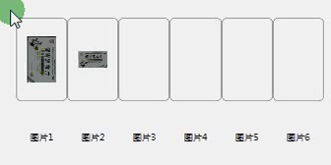
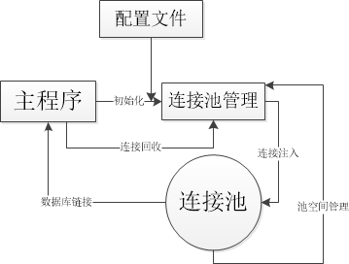
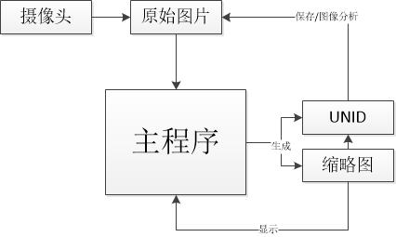
Project involved
Drug box recognition
Major Contributions：
Implement advanced UI
Challenges:
Drag images between controls
Database Module
Challenges:
Design a Connection pool to
separated the UI and data I/O
Data flow Optimize
Challenges:
Use temporary file to reduce
memory usage from 1GB->200MB
© 2018 Ricoh Software Research Center (Beijing) Co., Ltd.
7
Notes:
The first project is Drug box recognition. In this project, my role in this project is a developer. I did 3 major contributions in this project.
The first contribution is to implement the Advanced UI. In order to improve the user experience and reduce the complex operation, Hou san design this advanced UI ,such as multiple select and Drag images between controls, and I come true this,;
The second one is the Database module. With the increase in data, we will import Database to help the data management. So I add database operations in the application , and come true an assist application to help batch data import. However, the frequently data access made the application often be jammed, to solve this problem, I write a connection pool to separated the UI and data I/O.
The last one is a “Data flow Optimize” . In order to do image processing, this application used lots of HD imags, so the redundancy data flow often trigger Out of Memory Error. I use some temporary file to replace the large size file to flow in the application. The memory usage will reduced from 1GB to 200MB.

Slide 8
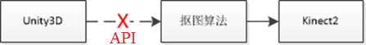
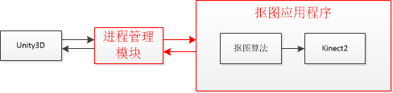
Project involved
Kinect2 image mapping and composition
Major Contributions：
Our algorithm is based on
Kinect2, only support Frameworks4.
Client’s platform only support
limited frameworks 2.
API can’t direct connection
My target in this project is to come true the API between client’s platform and our algorithm;
Resolved the unmatched problem
1. I designed this data exchange architecture;
2.Coding and test this API
© 2018 Ricoh Software Research Center (Beijing) Co., Ltd.
8
Notes:
In this project , my role also is a developer. This project is cooperate with Wang xiaoxue. She is in charge of algorithm design. I’m in charge of API design. But our algorithm is based on the Kinect 2, which is only support Frameworks 4.But our client’s platform only support limited frameworks 2.
The same program language, but different version make the API can’t direct connection. So , after analyze the 2 part, I design an inter-task management to make the connection. This method is simple and reliable.

Slide 9
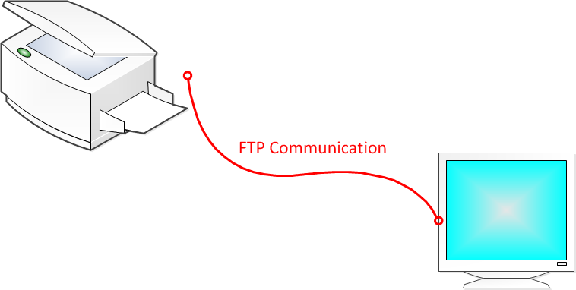

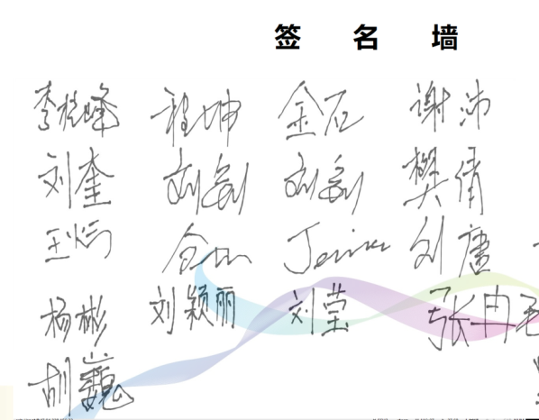
Project involved
RCN Sign & Display APP
Major Contributions：
Challenges:
Come true a high required system
on an unfamiliar development
environment in a month
FTP communication
Designed FTP
communication architecture
On site implement
© 2018 Ricoh Software Research Center (Beijing) Co., Ltd.
9
Notes:
RCN Sign & Display APP project is a very typical “limited time”, “unfamiliar development environment ”, “high quality ” project. We have only 1 month to finish this system from a simple idea.None of us have experience in developing on a printer and we don’t have time to test a appropriate technical route.
So, based on the running environment and my experience, I designed FTP communication architecture, it can simplified the complexity of communication between RICOH MFP and display devices. Then a simple test confirmed my assumption.
In order to make the display more vivified. I added some animation modules in the application.
And the last contributions in this project is I have over come so many difficulties to make sure the DEMO runned smooth and steady on the RCN conference.

Slide 10
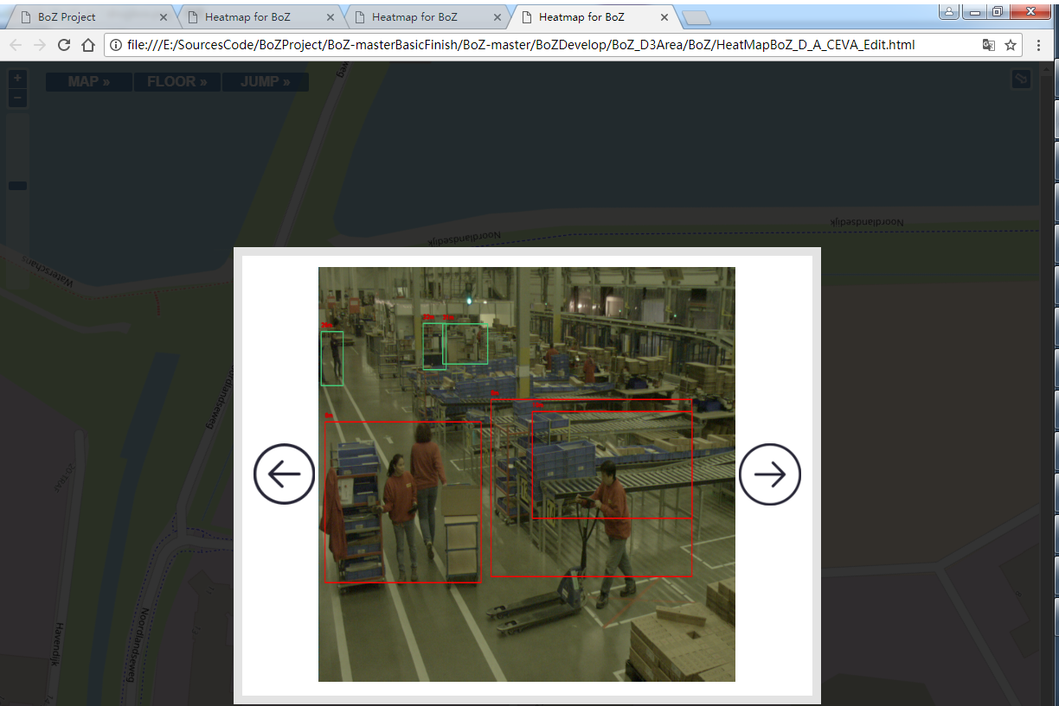
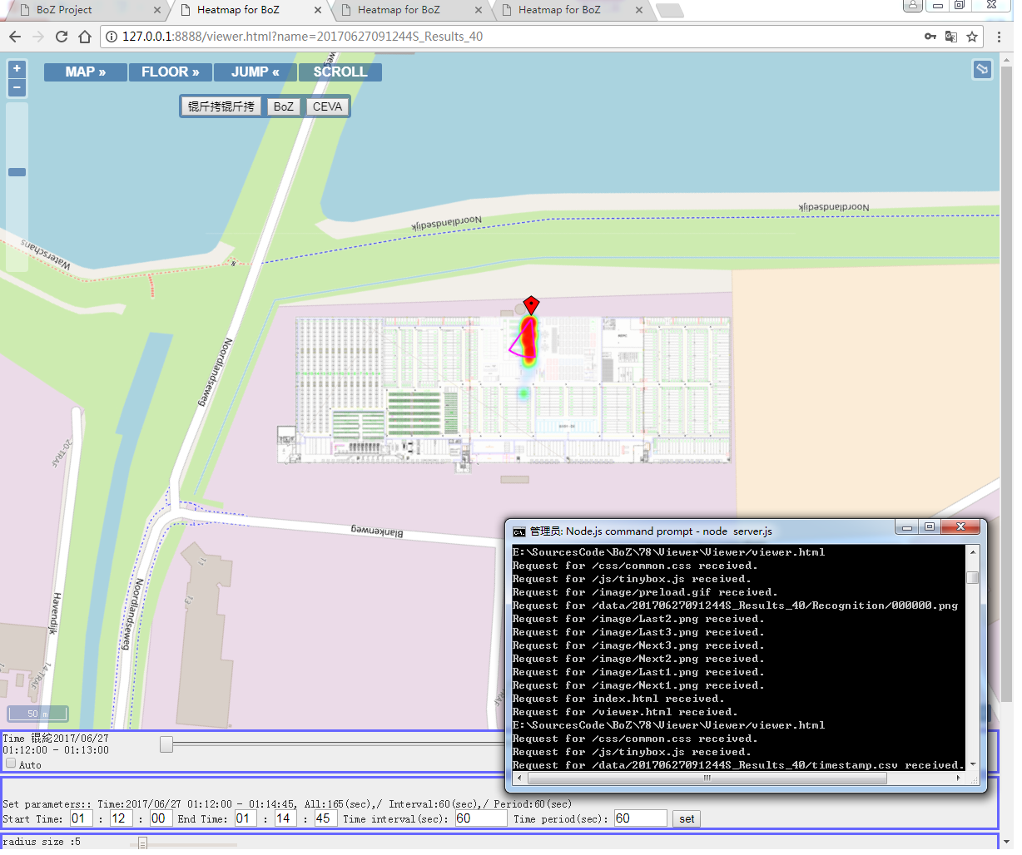
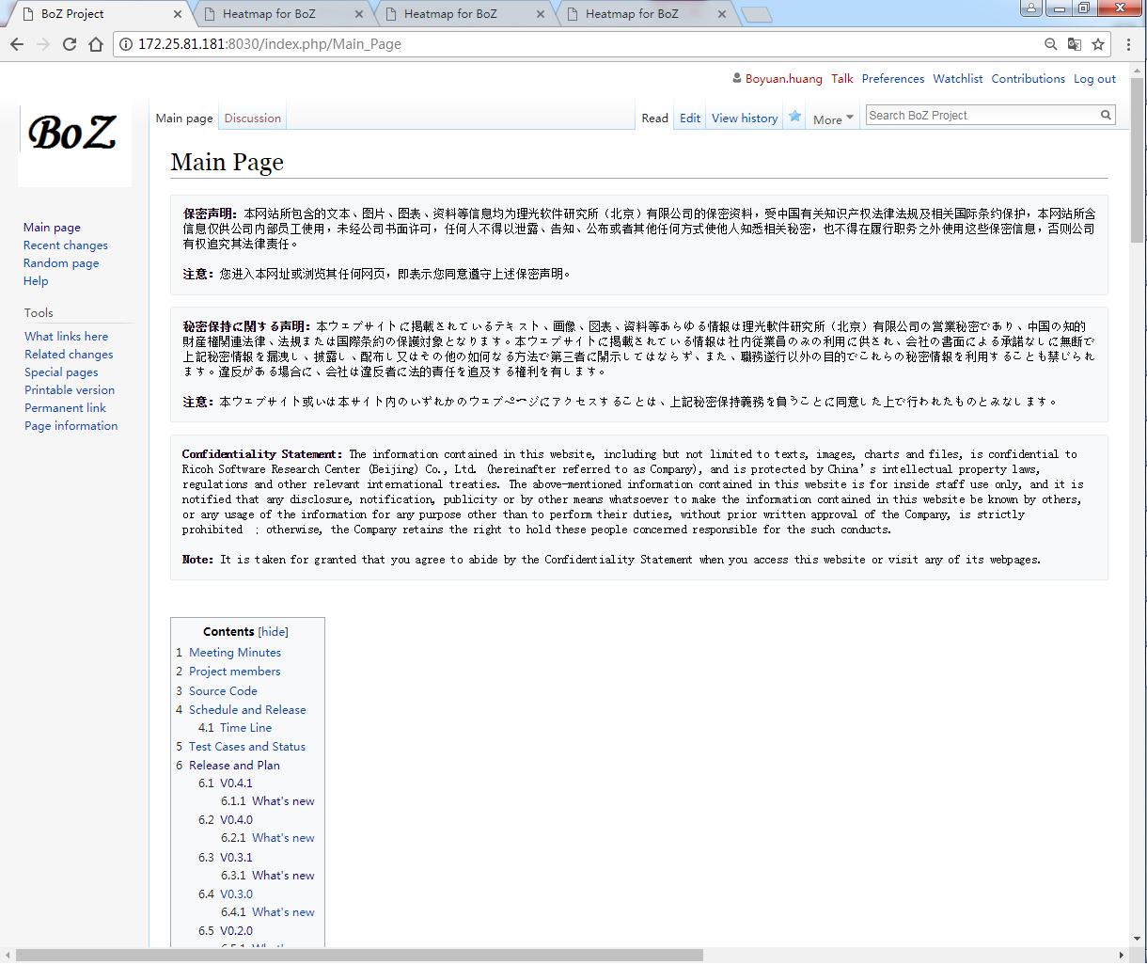
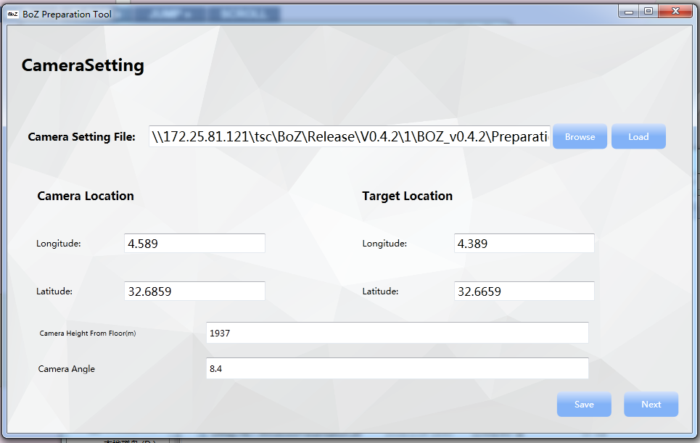
Project involved
My First PL project
BoZ Project
Prototype
Developed a demo based on Japan’s Requirement
Proposal
Communicate with Japan to confirm the requirement.
Write proposal document
Development
Develop Preparation tool
Develop Viewer
Test
Release
Major Contributions：
Write the proposal and manage the project;
Do the communication with Japan;
Develop all the project by myself;
Maintain a Wiki page for any update;
Maintain
Fix bugs
Maintain Wiki pages
© 2018 Ricoh Software Research Center (Beijing) Co., Ltd.
10
Notes:
The last project I want to talk is the BoZ Project. It’s my first time to work as a Project Leader. I have been experienced all the stage of a project would through.
The first stage is a prototype stage. In this stage, I wrote a simple demo based on the Japan’s requirement. After the prototype was confirmed, I communicated with Japan side many times to confirm the requirement and wrote the proposal document on our common view.
Then this project gone to the development stage. According to the proposal document, I chose the technical route to develop the Preparation tool and Viewer. Test the applications based on the test cases and release them. Up to now, those applications have been iterated 6 times.
And the last stage is maintain stage. In this stage ,we fix the bugs and maintain a Wiki page, which is used to make the information exchange more effectively.
In general, in this project , I have done those contributions :……………

Slide 11
Project involved
BoZ Project
Learned from BoZ Project：
I’ve learned how a project was going and how to communicate with client;
Make sure a project must be finished on time;
Every conference or talks must be recorded and confirmed;
Familiar project management of SRCB and Ricoh;
How to manage group members in a project: distribute task to the right person;
Important and urgent tasks must within someone’s power;
Normal tasks are good opportunity to help group members to challenge themselves;
© 2018 Ricoh Software Research Center (Beijing) Co., Ltd.
11
Notes:
In fact, I have learned lot of from this Project. May be more than all the projects before.
In this project, I have to experience a project in a total different way, not just only how to code an application. A project will though many stages from a basic idea to the end. And the most important thing in a project is to make the project must be finished on time!
But the most fuzzy thing in a project is communicate with our client .We need to keep in touch with then to make sure we are always on the right way . And the key of effective communication is to make every conference or talks be recorded and confirmed by both sides.
And another thing I learned from it is how to manage group members in project tasks, that is distribute task to the right person. All in all, the important and urgent task must be within someone’s power. But the normal tasks can be used to help group members to improve their ability, that means it can be fault-tolerant.

Slide 12
Content
Personal Information
Project involved
Future and Plan
© 2018 Ricoh Software Research Center (Beijing) Co., Ltd.
12
Notes:
At the last part , I want to talk about my work plan in the future.

Slide 13
Future and Plan
Engineering
Programme
Presentation
Language
Expert
Project Leader
Programmer
Core Competitiveness
Plan
1.Improve software skills , especially on the video technique;
2.Enlarge my range of technique exchange, such as to attend some technical forum;
3.Extend knowledge system, keep a watchful eye on the USE of some popular tech, such as AI, Video Live, Blockchain and etc.
© 2018 Ricoh Software Research Center (Beijing) Co., Ltd.
13
Notes:
In the 2 years, I have been experienced many projects. However, thanks to those projects, I’m not only finished my basic jobs, but also give me lots of practices and overcome kinds difficulties. So, at last, I have learned kinds of skills from them to support me to do more challenging jobs. Just like to climb stairs, I have been grown from a low level programmer to a project leader. It’s so grateful that our company can provide such a nice environment to let everyone get practice and grow up.
However, if I want to go further, I need to do more . There are 3 things I must to do in the future if I get the promotion.
1.Improve my software skills, especially on the Video technique;
2.Enlarge range of technique exchange, such as I can go to attend some technical forum to get some fresh information.
3.Extend my knowledge system , keep a watchful eye on the use of some popular technique, such as AI ,Video live, block chain and so on
I think I can do much more better if I get the promotion.

Slide 14

Q&A
© 2018 Ricoh Software Research Center (Beijing) Co., Ltd.
Notes:
That’s all my report. Thanks again for listening!

